Slide 1
Main Memory Lesson 4 Swapping
David Liu
Fall 2021, Spring 2022

Slide 2

What & Why Swapping
Swapping:
A process can be swapped temporarily out of memory to a backing store, and then brought back into memory for continued execution
Reason:
Total physical memory space of processes can exceed physical memory
Backing Store
fast disk large enough to accommodate copies of all memory images for all users; must provide direct access to these memory images

Slide 3
Swapping
Roll out, roll in – swapping variant used for priority-based scheduling algorithms; lower-priority process is swapped out so higher-priority process can be loaded and executed
Major part of swap time is transfer time; total transfer time is directly proportional to the amount of memory swapped
System maintains a ready queue of ready-to-run processes which have memory images on disk

Slide 4
Swapping (Cont.)
Does the swapped out process need to swap back in to same physical addresses?
Depends on address binding method
Plus consider pending I/O to / from process memory space
Standard Swapping
Moving the entire process between main memory and a backing store
Modified versions
Swapping pages, not an entire process
UNIX, Linux, and Windows
Swapping normally disabled
Started if more than threshold amount of memory allocated
Disabled again once memory demand reduced below threshold

Slide 5
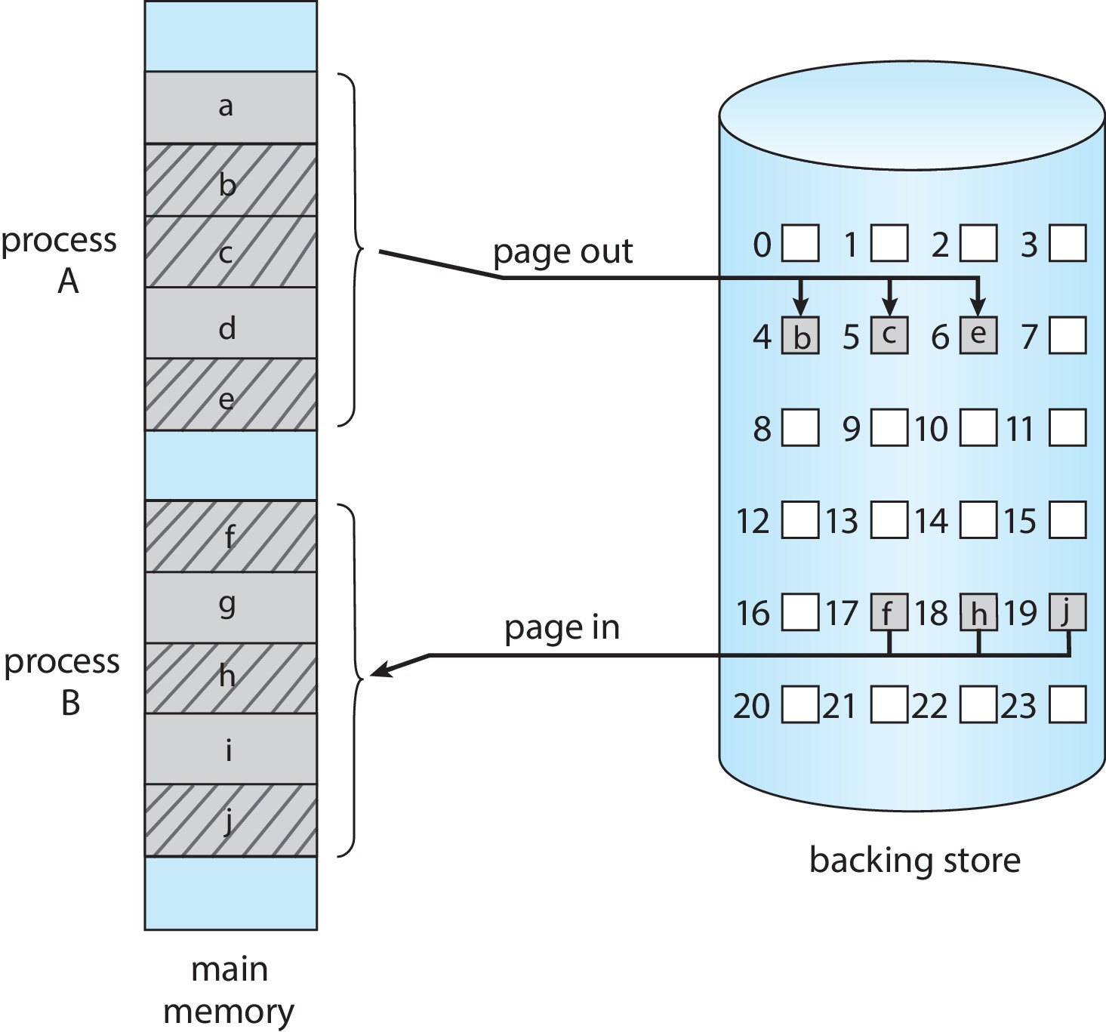
Swapping with Paging

Slide 6
Swapping on Mobile Systems
Not typically supported
Flash memory based
Small amount of space
Limited number of write cycles
Poor throughput between flash memory and CPU on mobile platform
Instead use other methods to free memory if low
iOS asks apps to voluntarily relinquish allocated memory
Read-only data thrown out and reloaded from flash if needed
Failure to free can result in termination
Android terminates apps if low free memory, but first writes application state to flash for fast restart
Both OSes support paging as discussed below

Slide 7
Mobile App Memory Usage Caution
Mobile systems and apps developers must carefully allocate and release memory to ensure that their applications do not use too much memory or suffer from memory leaks.

Slide 8
System Performance
Swapping pages is more efficient than swapping entire processes
Swapping is a sign there are more active processes than available physical memory
To solve the problem
Terminate some processes
Get more physical memory

